Slide 1
Fostering a praxis of spatial justice in suburban churches:
An emancipatory approach
A research study conducted by Caroline Powell towards a Masters in Practical Theology
With the Centre for Faith and Community, faculty of Theology and Religion, University of Pretoria
Academic Supervisor: Prof Stephan de Beer

Slide 2
Chapter 1
Relocating Spatial Justice
Urban theologies and spatial justice
Locating myself as the researcher
Purpose of the study
Research associates
A historical overview leading to this study
Locating church land justice in the cities and suburbs of South Africa
Introducing the Praxis cycle
Research contribution

Slide 3
Chapter 2
Methodologies of an emancipatory research approach
Theoretical Frameworks for this Research
Qualitative research
An emancipatory approach to research
Research procedures
Research Sample Group
Data collection
Data collection exercises and questions
Data analysis
Ethical Considerations

Slide 4
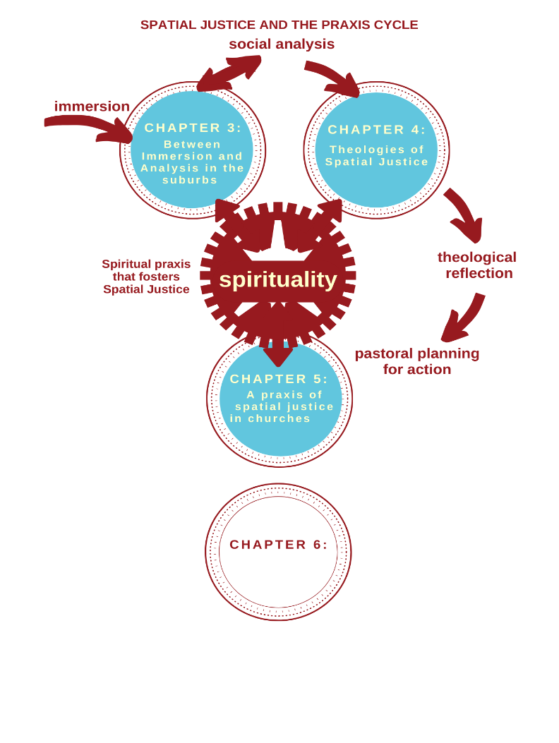

Slide 5
Chapter 3
Between a spatial Immersion and Analysis in the Suburbs
Immersed in the suburbs
A spatial history of suburban Cape Town in the context of South Africa
Suburban studies
Suburban churches
Voices from suburban churches
A general description of space
An analytical description of church and space
Analysis with a Spatial (in)justice lens
Foundational concepts: naming space, place, justice and injustice
Churches and spatial (in)justice
Voices from the churches
Churches holding different living memories of the same area
Churches uncovering unheard stories
Exclusionary suburbs and the churches in them
Churches on either side of “the bridge”
Churches as the bridge?
Churches and their neighbours “under the bridge”

Slide 6
Chapter 4
Theological reflection towards Spatial Justice
Theologies toward spatial justice
Leading, developing, and emerging theologies of spatial justice
A black liberation theology of land and spatial justice
A prophetic imagination for spatial justice
Contextual readings of the Bible: a possible resource to facilitate a spatial turn in churches
Voices from the churches
The holistic gospel
The Kingdom of God
Incarnation
A theology of the neighbour(hood)
A theology of economic and land justice
A theology of the church
A theological imagination for spatial justice?
Sources that influenced the theological reflections of the ministers

Slide 7
Chapter 5 - a praxis of spatial justice in churches
The quest for an integrated Cape Town – social movements, urban spatial laws and the city
Churches and a praxis of spatial justice
International stories
South African stories
Churches and movements for urban land rights
A Housing Company motivated by Christian love, hospitality and justice
When they said “stay at home”, we said, “where?”
Voices from the churches
Not just for a Sunday morning
The church, the community, the neighbourhood
A church for the neighbourhood
Churches that (could) change the community/ neighbourhood
Influencing factors
Factors that could influence a praxis of spatial justice in either direction
Factors that could explicitly hinder a praxis of spatial justicNew
New Hope in/from the suburbs?
Use of space explicitly for ministry purposes related to social inequality and injustice
Stories of church space use that moves towards a praxis of spatial justice
Across the divides of the city: further afield

Slide 8
Chapter 6
Future(s) for the church on the corner
Lenses for a church-based praxis of spatial justice
Revisiting the emancipatory aims of this study
Feedback from ministers
Researcher feedback
Questions and commitments for future emancipatory research
Potential future research that this study has surfaced
Conclusion

Slide 9
Takatso Mofokeng (1997)
A brutal dispossession of African land has been legitimized and legalized in the Codesa agreement. This means that a white theology that attributes the criminal dispossession to God viz. that God gave them land, has been given State sanction. In this regard instead of calling that violent dispossession a sin, it has been turned into God’s blessing. This further means that our dispossession has been turned into God’s act of punishment which Africans have to painfully accept….[W]e also have to conclude that socially speaking, a Black Theology of land that is developed upon the basis of the fundamental illegitimacy and sinfulness of dispossession, has to oppose the political compromise that provided the basis for legalization of the sin of land dispossession. That compromise is a sin because it legalized a sinful act of land dispossession. It is also a sin because it legalized the creation of a perpetual state of poverty and loss of culture and identity of the African people. It laid the political basis for the development of a heretical theology of land.

Slide 10
That our geographies and histories are socially produced
and not simply given to us by god or nature
leads to an awareness that the geographies in which we live can have both positive and negative effects.
They can provide advantage and opportunity, stimulate, emancipate, entertain, enchant, enable.
They can also constrain opportunity, oppress, imprison, subjugate, disempower, close off possibilities.
In our terms, geographies or spatialities can be just as well as unjust,
and they are produced through processes that are simultaneously social and spatial, subjective and objective, concretely real and creatively imagined.
(Soja 2010:104)

Slide 11
… one cannot engage the question of space in settler colonies without considering it within the bigger movement of conquest, colonisation and the universalisation of Europe. Space, specifically in the form of land, was the central point of contention between conquerors and the conquered
… the questions raised by a spatial theology are best addressed through the work and mediations of liberation theology. The prioritising of the question of liberation and justice will inevitably lead to the prioritising of questions of space and land
(Delport and Lephakga 2016)

Slide 12
Philpott and Zondi (1999) from the Church Land Programme:
The type of land owned by the church ranges from small urban plots for a local church building to large rural farms for both residential and agricultural purposes. For the purposes of land reform, it is presumed that it is the rural land-holdings of the churches which are of interest, and this study attempts to highlight these and will focus on the possibilities regarding the larger rural land-holdings. However, information is provided on local church plots to provide the context of church land in general

Slide 13
Denomination | Number of Properties | As % of Total | Area of Properties (Ha) | As % of Total
ELCSA (Lutheran) | 122 | 6% | 57 146 | 31%
Moravian | 10 | 1% | 55 103 | 30%
Roman Catholic | 315 | 15% | 40 738 | 22%
NGK (Dutch Reformed) | 600 | 30% | 14298 | 8%
CPSA (Anglican) | 379 | 18% | 7131 | 4%
Methodist | 450 | 22% | 2027 | 1%
Presbyterian | 79 | 4% | 2579 | 1%
United Congregational | 29 | 1% | 2031 | 1%
Salvation Army | 61 | 3% | 1898 | 1%
Other | 8 |  | 2
Total Amount | 2053 | 100% | 182 953 | 100%
Church-owned land in South Africa Philpott and Zondi (1999:23)

Slide 14
I affirm Philpott and Zondi’s assertions that for effective land reform and redistribution to happen at the hand of the church in South Africa, the larger rural and peri-urban land-holdings are critical spaces of engagement. However, I believe that in the two decades that have passed since this initial audit, there has not been enough research focus on the many relatively small pieces of church-owned land in the inner cities and suburban areas of our country. This is especially important in light of the rapid urbanisation of our country and continent, and the shifting demographics of church attendance and property use. In the literature on church-owned land in South Africa, I have not found further data on church-owned urban and suburban plots in South Africa and have found very few documented case studies that significantly bring this decades-old discussion into conversation with emerging theologies and case studies of spatial justice.
(Me:2021)
☺

Slide 15
Central question:
What does a spatial justice praxis look like in churches located in former Whites-only suburbs of Cape Town?
Sub-questions:
Are the churches aware of issues of spatial injustice in their historical and current context?
Do churches in the sample group have a developing consciousness and theology of spatial justice?
What theological reflections and practices are present in the churches that either foster or hinder spatial justice?
Is there a role for research with an emancipatory approach in fostering a praxis of spatial justice?

Slide 16
The purpose of the study was to foster a praxis of spatial justice in suburban churches in Cape Town through undertaking participatory action research with an emancipatory approach with ministers who elected to be part of the study. The research set out to explore the interrelated dynamics of reflection and action in suburban churches as they relate to the concept of spatial justice:
Reflection: the theories, thoughts and influences, specifically theologies, that the churches engage with that shape the spatial consciousness of their corporate lives
Action: the spatial decision-making, practices and activities as lived faith of the churches
The dynamic interplay between action and reflection in which reflection determines action and action influences reflection

Slide 17
Haight and Nieman (2009) call for
‘theology that stands in service to the church’
asserting that it is essential that such research ‘engage accurately and amply with the local realities, sorrow, and hopes of actual assemblies of the faithful’
“Without this check, theological study can risk becoming insulated from the world in which it tries to speak, and thus its gifts of wisdom and reflection become muted or subverted. Not only is the field of theology hurt by this, but congregations also desperately need the connections, perspectives and mediation theology can bring.”

Slide 18
This research project was committed to:
bringing robust theological research and reflection to churches
while simultaneously bringing the lived realities of the churches to theological discourse
all towards the greater purpose of seeking a praxis of spatial justice in the cities of South Africa.

Slide 19
So what did I do?

Slide 20
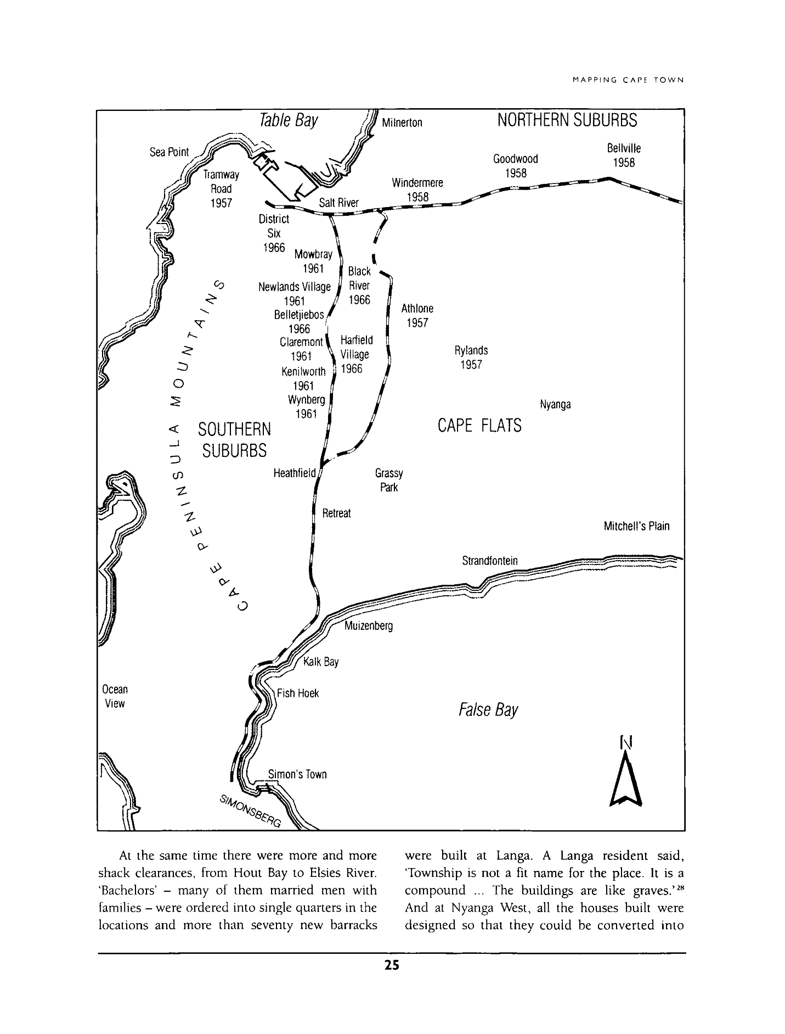
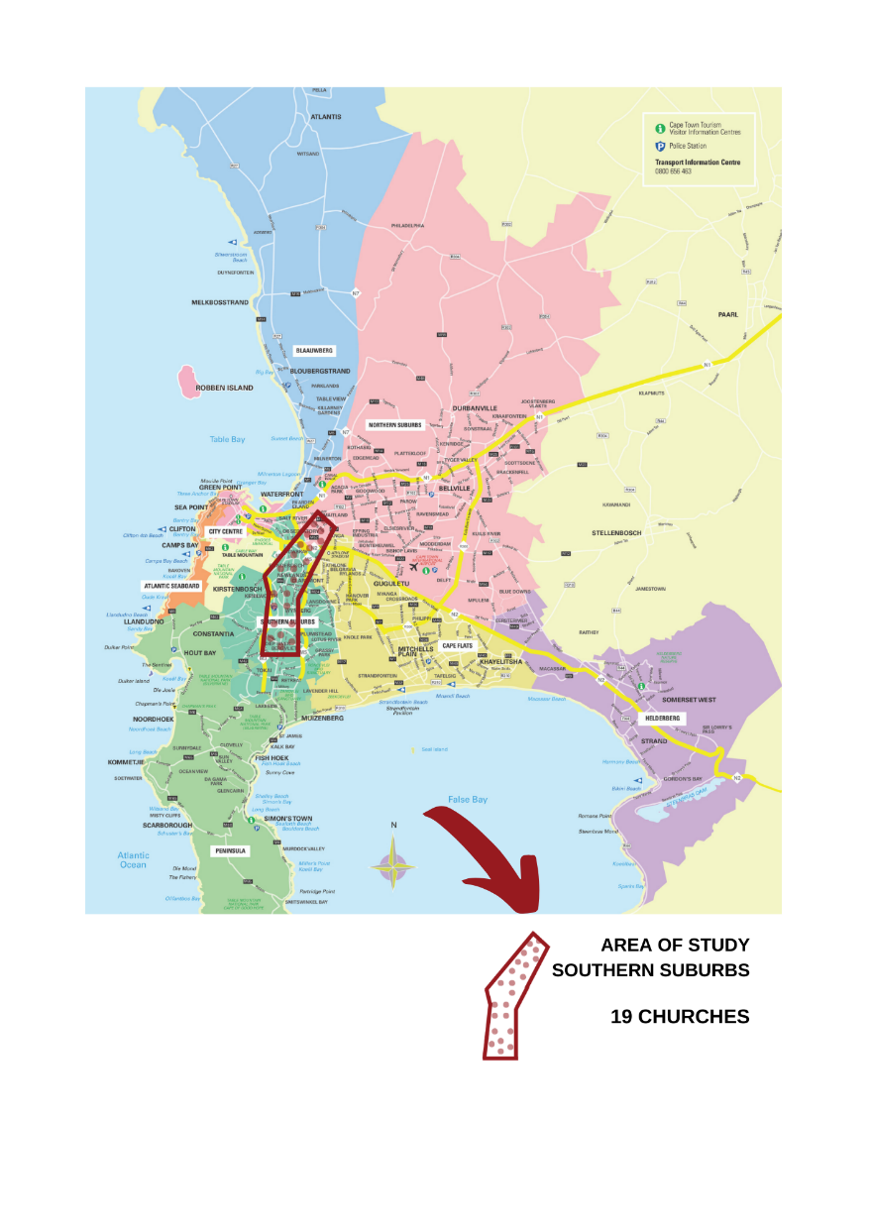
Map depicting areas of forced removals across the Southern suburbs of Cape Town (Bickford-Smith 2001:25)

Slide 21
Data collection method | Voice(s) recorded | Denomination
Focus Group Discussion - Group I | Ministers 1 - 6 Lay Leader 1 | 5 Anglican 1 Baptist 1 Methodist
Interview | Minister 7 | Methodist
Interview | Minister 8 | Anglican
Interview | Minister 9 | Anglican
Interview | Minister 10 | Baptist
Interview | Minister 11 | Baptist
Interview | Minister 12 | Methodist
Focus Group Discussion - Group 2 | Ministers 13 - 18 | Dutch Reformed
TOTAL | 19 | Anglican (7), Baptist (3), Methodist (3) Dutch Reformed (6)
Data collection technique used in this study with ministers, showing different denominations

Slide 22
Exercise 1:
Describe a moment in your church history when you most saw the physical space of your church (buildings and grounds) come alive in relationship to the immediate neighbourhood around you.
(an appreciative enquiry approach)

Slide 23
Exercise 2:
Here are several scenarios describing different church points of contact with the subject of this research, either listed on board (focus group discussion) or listed on paper (interviews).
- read them through and pick one that you would like to answer, one that feels closest to home
- think about the response that you, with your church leadership, might give to the questions provoked by the scenarios
- if there is nothing in these scenarios that feels familiar enough to reflect on then reflect on something similar that does, and describe it
- if there is a real case study that any of these scenarios remind you of (past or present) that you would be happy to describe, you may do that instead

Slide 24
Scenario 1
You recently did a survey with your congregation asking them what political and social issues concerned them the most. You were interested to hear that “Land Expropriation without compensation” and “an increase of street homelessness in the neighbourhood” featured in many of their responses. One family responded with a personal story of pain and deferred hope around a land claim from their time of being forcibly removed from their home during Apartheid that has still not been resolved.
How do you think your local congregation can address these concerns?

Slide 25
Scenario 2
The “social transformation/outreach/justice and mercy” team at your church hosts regular discussion nights. They invite someone to come and speak about a topic pertaining to issues of injustice and then they host a panel from the church that responds to the topic with theological and pastoral reflections.
Last month they hosted a speaker from a local urban land rights group and the discussion got quite heated.
Describe the kind of differing voices you think would emerge on such a night and what some of the panels responses might have been.

Slide 26
Scenario 3
You recently hosted a month of prayer and fasting at your church, with weekly gatherings for people to share what they sense about the future of the church. During this time, the topic of the church buildings emerged. Many people felt convicted that many of the buildings are not being used enough of the time. However, there were many different thoughts and suggestions that emerged about how to address this…
Describe a few possible suggestions you imagine would emerge from your church membership and leadership
Scenario 3
You recently hosted a month of prayer and fasting at your church, with weekly gatherings for people to share what they sense about the future of the church. During this time, the topic of the church buildings emerged. Many people felt convicted that many of the buildings are not being used enough of the time. However, there were many different thoughts and suggestions that emerged about how to address this…
Describe a few possible suggestions you imagine would emerge from your church membership and leadership

Slide 27
Scenario 4
You are approached by a group of students in your church. They have been having conversations about land and spatial injustice and inequality in South Africa. They have some concrete suggestions for the church:
that the church become actively involved in learning from and supporting urban land rights movements,
some of the church buildings be available for affordable accommodation for those who could otherwise not afford to live in the area,
that the church earnestly plan how to do restitution with the land they own
How do the leadership respond to these questions and suggestions?

Slide 28
Scenario 5
A couple in your church has a large property with several garden cottages and space indoors. They have recently felt that they should open their home to accommodate people without houses and they are asking the church to help them discern how best to do this.
What do you advise them?

Slide 29
Scenario 6
You have recently become aware of several congregants facing eviction from the nearby council houses that they live in, as well as ongoing evictions and demolition of “informal” dwellings in a nearby informal settlement that has developed under a bridge close to your church.
Several concerned congregants highlight this at a church meeting, asking what the church community is going to do about this?
What kind of response do you think your church leadership will discern?

Slide 30
Scenario 7
A family has just moved into the neighbourhood and they come to meet you for coffee at your church.
Their grandparents were forcibly removed from the same neighbourhood in the 1960’s and they explain how their return to the suburb is one filled with mixed emotions. They are looking for a local church to attend and are interested to know how your congregation is journeying with the story of your shared history in the neighbourhood.
Describe the conversation that follows …

Slide 31
Scenario 8
A relationship is forming between your church and a church in Philippi when disaster strikes a week before Easter. A fire destroys the Philippi church buildings and even causes damage to some congregants’ homes.
Several of the church members require emergency accommodation in order to keep their jobs in the City.
How do you see your church congregation and leadership responding to this?

Slide 32
Exercise 3:
Here is a short survey about the community, location, physical space and usage of your church.
As you look at the survey, please share some responses you may fill in for your church.
Please also comment on what you think is missing or problematic in the survey.
https://docs.google.com/forms/d/e/1FAIpQLScImfCMk9ar8K2t5V9okqiJC1ipr0mxRD0WZVhGHlH_QN82yg/viewform?vc=0&c=0&w=1

Slide 33
Exercise 4:
Thinking about our discussions to this point:
what theological ideas came to mind while you were reflecting?
what theological ideas and resources do you think inform your responses?

Slide 34
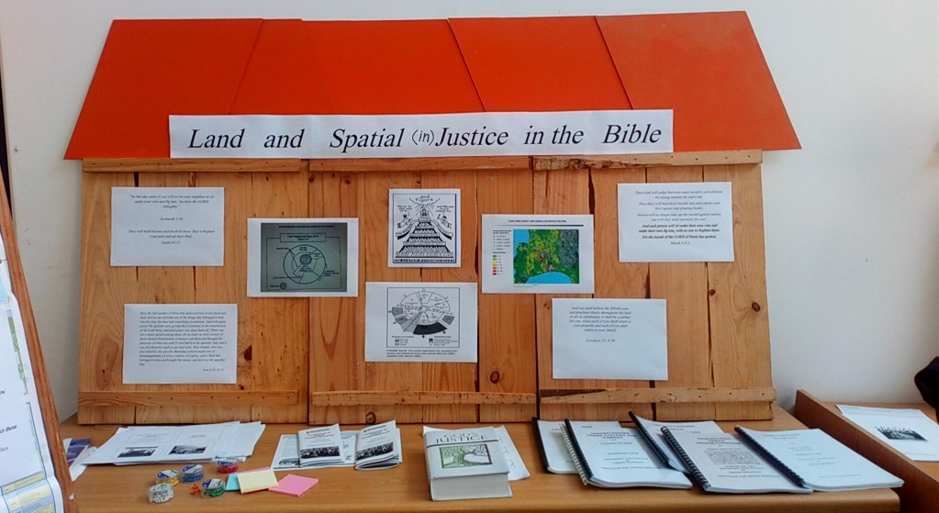
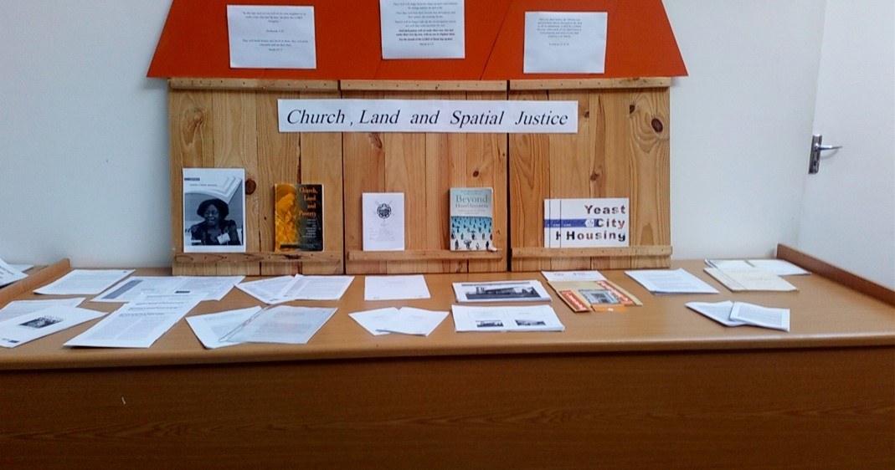

Slide 35
And what did I find?

Slide 36
Immersion
A general description of space
Churches that mostly reflect the current demographics of the suburbs in which they are located
Churches that mostly reflect the demographics of people who were forcibly removed from the neighbourhood during apartheid
Churches with a combination of people who currently live in the neighbourhood and those who were removed from the neighbourhood
Churches whose racial demographics are diversifying: because… 1) Church leaders have made an intentional commitment to address the segregated stories of the past or 2) the suburb is diversifying
An analytical description of church and space
White spaces
Wealthy spaces
Apartheid spaces
Suburban spaces

Slide 37
Social Analysis
Churches holding different living memories of the same area
Churches uncovering unheard stories
Exclusionary suburbs and the churches in them
Churches on either side of “the bridge”
Churches as the bridge?
Churches and their neighbours “under the bridge”: a problem, an opportunity for outreach, members of the community

Slide 38
Theological reflection toward spatial justice
Leading, developing, and emerging theologies of spatial justice
A black liberation theology of land and spatial justice
A prophetic imagination for spatial justice
Contextual readings of the Bible: a possible resource to facilitate a spatial turn in churches
Voices from the churches
The holistic gospel
The Kingdom of God
Incarnation
A theology of the neighbour(hood)
A theology of economic and land justice
A theology of the church
A theological imagination for spatial justice?
Sources that influenced the theological reflections of the ministers

Slide 39
building blocks of a praxis of spatial justice in the churches ?
Not just for a Sunday morning
The church, the community, the neighbourhood
A church for the neighbourhood
Churches that (could) change the community/ neighbourhood
Ecclesial use | Income-generating: space for hire | Use of building offered at no cost to serve local community/neighbourhood | Specifically named as coming from a sense of social and/or spatial justice
Sunday morning/evening services | Body corporate meetings of neighbouring residential complexes | Open grounds for dog walking | Use of space given freely as office space to NPO’s addressing inequality and injustice in other parts of the city
Mid-week services | Alcohol/Narcotics Anonymous meetings | Open grounds and buildings during neighbourhood festivals | A deliberately racially and economically integrated pre-school
Prayer services | Dance/exercise classes – daily hire during the week and Sat mornings | A quiet space for the public during times of crisis (e.g. fees must fall) prayer/debriefing offered | A respite flatlet for individuals/families in crisis; often used for people facing homelessness
Weddings | Event hire | Free space is given for social enterprise micro-business | Emergency shelter for displaced people (temporary)
Funerals | Weddings of non-congregation members | Western Cape blood transfusion | Winter Shelter for homeless persons over a few days during heavy weather
Church socials | Preschool/Educare | Free live music concerts | After school tutoring/homework clubs
Church celebrations – e.g. patronal festivals | Film shoots | Recreation clubs for the elderly or special needs groups | Daily clinic for babies and children (run from a church building – freely given for the use of the clinic)
Annual church fete/market day | Parking for local businesses | Parking for school drop off and collection of neighbouring high school | A clinic where people collect chronic medication – to reduce long travel time and waiting time at a government clinic
The Alpha course and other evangelical initiatives | Weight watchers | Weekly or Monthly dinners hosting people who live on the streets near the church with congregations members (not a soup kitchen) | Long term housing of refugee families in homes owned by the church
Packing food parcels once a month for Fikelele | Training/workshops/ courses venue | Courses that serve community needs: The Marriage course Depression Matters Griefshare Divorce recovery Parenting courses | One church was, at the time of the focus group, going through a process of discernment on how to use a vacant building in more spatially just ways
Bible study groups | Run/walk for life | School for children with disabilities | Small scale urban farming/ vegetable gardening on available pieces of soil
Worship events Choir practice | A residence for ten students | Parents/Nanny and child meet-ups and support groups

Slide 40
Influencing factors
Factors that could influence a praxis of spatial justice in either direction
The minister
The congregation
Money matters
Decision makers
Theological influence
Partnerships with NPO’s and other partners
Ecumenism
Location
Factors that could explicitly hinder a praxis of spatial justice:
Apathy
When things go wrong / security concerns
Does helping hurt?
“Not in my back yard”

Slide 41
New Hope in/from the suburbs?
Use of space explicitly for ministry purposes related to social inequality and injustice
Stories of church space use that moves towards a praxis of spatial justice
Across the divides of the city: further afield
Discussion of findings:
…. Church in the city, church to the city, church with the city – if theres time read from pages 147-149

Slide 42
So what did I make of all this?

Slide 43
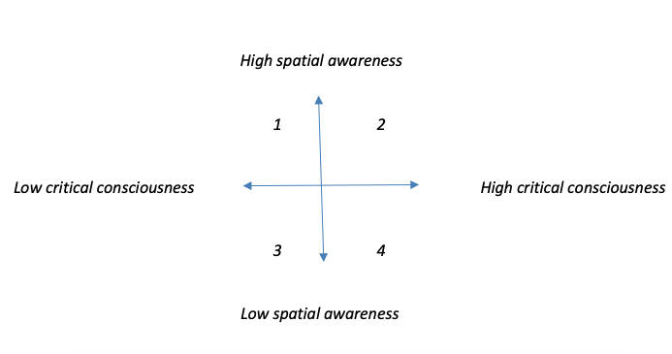
A lens for intersecting critical and spatial consciousness

Slide 44
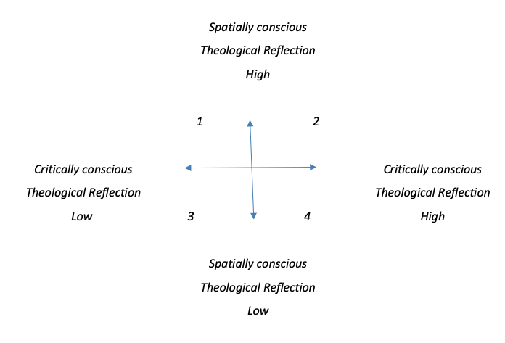
A lens for intersecting critical and spatial theological reflection

Slide 45
There were a variety of stories from across the dataset that did not directly lead from a conscious analysis and/or theological reflection into actual action.
Ministers frequently articulated a disconnect between theologically held convictions regarding socio-spatial (in)justice and the lived praxis of their church.
And so, in an emancipatory research approach to churches and spatial justice, I propose the use of these lenses to help frame questions and shape actions for each other as actors of faith in churches.
The aim of engaging these lenses would be to encourage each other towards ever-increasing spatial and critical consciousness as well as ever-increasing theological reflection with a socio-spatial lens.
And then, not to stop there, but to actively engage the influencing factors, identified in Chapter Five, that would promote or hinder a praxis of spatial justice …. And then work with commitment towards mitigating them !!

Slide 46
Practical ways of applying these lenses to foster a praxis of spatial justice in churches
Help spatial justice activists that are still in churches engage theologically and then help them engage their churches
Actively centre the theological building blocks of spatial justice
City as the classroom; pilgrimages; CBS; faith communities and spatial justice: appetizers for engagement
Process facilitation with church leadership and congregations who want to go on the journey
In these processes help churches listen to the voices of people who have been excluded and removed from their neighbourhoods
Motivate congregants with high critical and spatial consciousness and theology to become involved in spaces where church decisions are made: e.g. leadership/elderships teams, the buildings committee
Develop self auditing tools for churches to asses and address the use of their spatial and other resources

Slide 47
Possible future research
Decision-making in church leadership structures: how does this hinder or foster a praxis of spatial justice and who makes up the decision making powers of churches?
Homelessness and the suburban church: how do suburban churches and homeless communities work with one another towards spatially just use of church spaces in addressing suburban homelessness
Church building usage before and during the Covid pandemic and towards a post Covid world
Futuring church space: A study into new church building projects, and how churches are approaching/ could approach new building projects with a spatial justice agenda

Slide 48
Possible future research (continued)
An emancipatory approach to church land auditing in suburban areas towards a praxis of spatial justice with underutilized or unused buildings and space
Suburb-specific research – identify all the churches in the area to journey through the praxis cycle in their neighbourhood with spatial justice as the lens
Denomination-specific research – study the spatial justice praxis of individual denominations
Interfaith collaborations towards spatial justice
The relationship between churches and urban land rights movements

Slide 49
“Is there a future for the church on the corner?”
- A minister in the study

Slide 50
This emancipatory research approach …
when pursued by practitioners, researchers, church-goers and church leaders,
will lead to the uncovering of possibilities where suburban, and indeed other, churches may start to think and act towards their presence in their cities with spatially just lenses.
In this future, I see local churches that will flourish, strengthen and grow, albeit perhaps not in ways that many might currently be imagining or framing church growth.
In such a future I imagine as many models for a praxis of spatial justice as there are churches.
Conversely, should such lenses not be engaged and an emancipatory agenda not be embraced, the suburban church of Cape Town may watch a moment of profound prophetic potential to contribute toward the South African urban land and spatial justice question slip away.

