Slide 1
Can churches create safe spaces in a time of crisis and beyond?
Lessons learnt in 2020
An interactive workshop
Facilitated by:
Caroline Powell Charlie Alexander Wayne Renkin

Slide 2
Welcome!
We look forward to going on a journey together
over the next two hours, weaving together
… your stories,
… our stories
… and the stories of churches and people we are walking with
together paint a picture of the possibility of churches as a prophetic and alternative community spaces
in the crisis of injustice and inequality

Slide 3
Flow of the workshop:
Session 1: “Your stories” … in discussion groups and reflected back to the whole group
Session 2: “Our stories”... from Cape Town, Tshwane and beyond
Session 3: Reflection on the all the stories … noticing themes, synergies, disconnects, possibilities
Session 4: looking ahead

Slide 4
Are you ready to participate?
Grab a pen and paper to make notes of
thoughts, ideas, themes, question that emerge during the session
Are you ready to join a breakout group when you’re assigned? :)
Familiarise yourself with the chat box function on your device
We welcome videos ON to see your lovely faces …
BUT PLEASE DO MUTE YOURSELF IN THE PLENARY SESSIONS

Slide 5
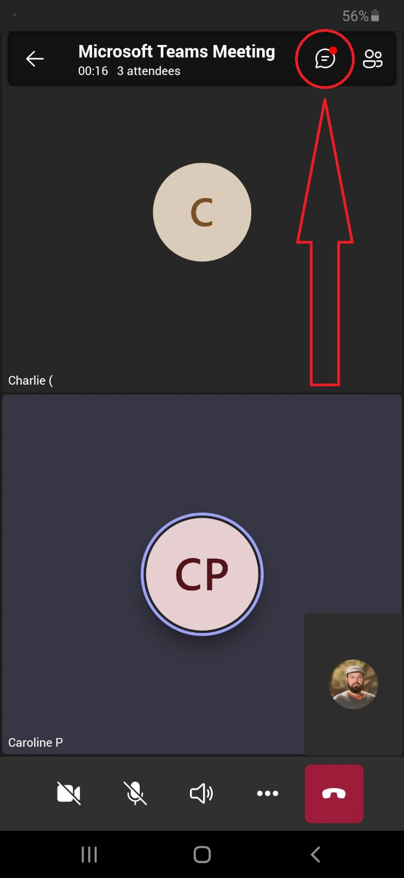

Slide 6
“Your stories” … Small group discussions
20 minutes
There will be three breakout groups and each one will have one of the facilitators in the group to lead the conversation

Slide 7
Feedback from discussion groups
Sharing the quality (not the quantity!) of our conversations
What have you heard from other participants during the breakaway rooms?

Slide 8
“Our stories” …
2020, churches, home and homelessnes, safe spaces?
… from Cape Town, Tshwane and beyond

Slide 9
Churches as safe spaces … “just imagine”
Reflections from Cape Town and beyond
Caroline Powell
Notes:
Reflect on a conversation in March 2020 … just completed all he interviews with churches looking at spatial justice … identifying hindering and promoting factors regarding churches using their resources towards spatially just suburbs, neighbourhoods and cities in post apartehid SA. The announcement had just been made the president to tell the whole of SA to stay at home and those who were living on the tsreet of the country said “where?” I was on call with on of my colleagues and we allowed ourselves to dream just a little bit … we said “just imagine” if every church in Cape Town offered a safe space to 5-10 homeless persons during the lock down… tell a little of the story …. So what would it take for the church to have such a “JUST IMAGINATION”

Slide 10
“Everyone will sit under their own vine and under their own fig tree,
and no one will make them afraid,
for the LORD Almighty has spoken.” Micah 4:4
“They will build houses and dwell in them; they will plant vineyards and eat their fruit.” Isaiah 65:21
“There were no needy ones among them, because those who owned lands or houses would sell their property, bring the proceeds from the sales, and lay them at the apostles’ feet for distribution to anyone as they had need.” Acts 4:34-35

Slide 11
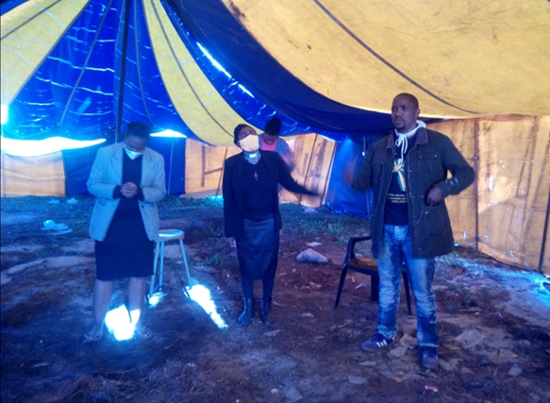

Slide 12
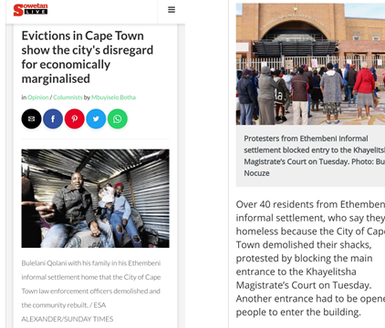
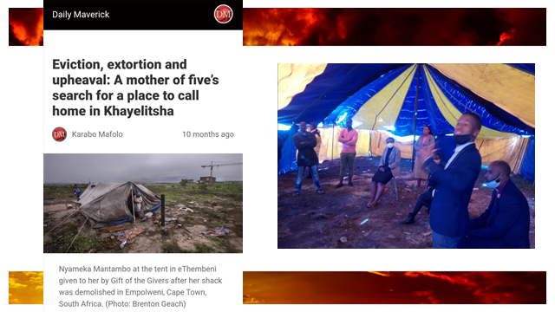

Slide 13
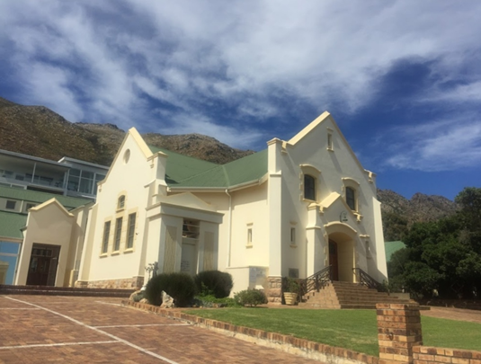

Slide 14
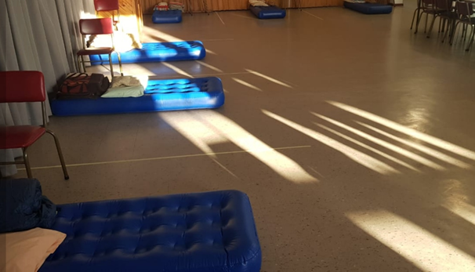

Slide 15
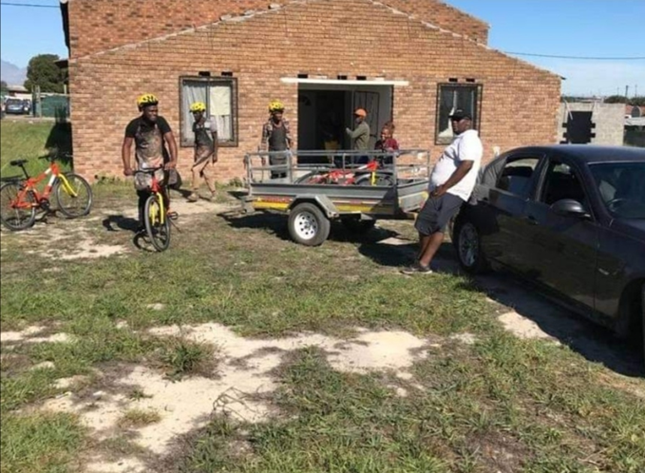

Slide 16
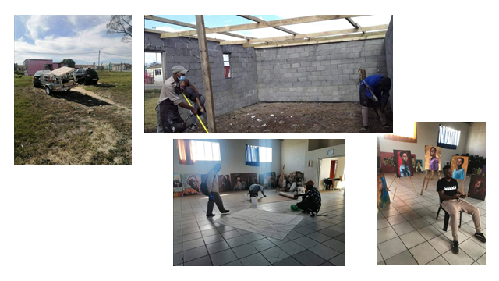

Slide 17
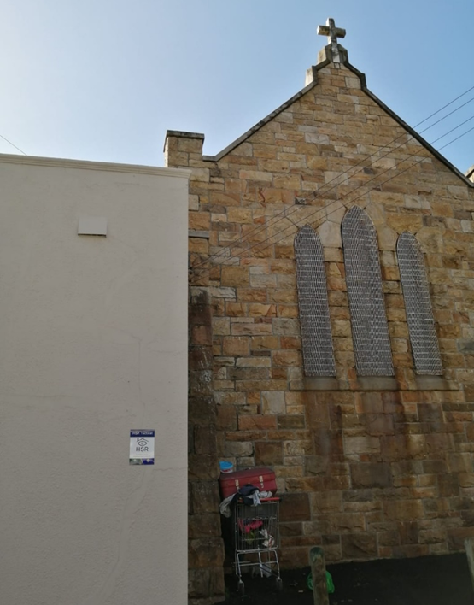

Slide 18
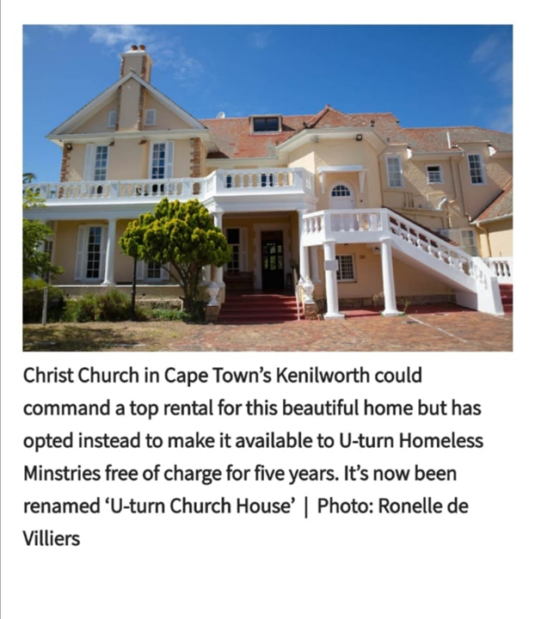

Slide 19
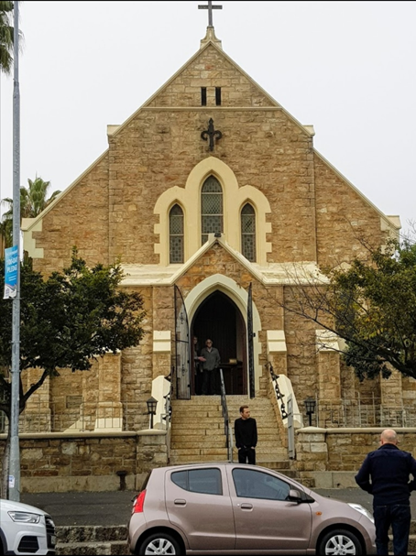

Slide 20
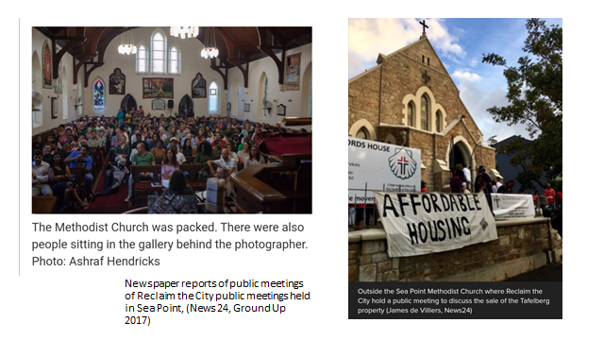

Slide 21
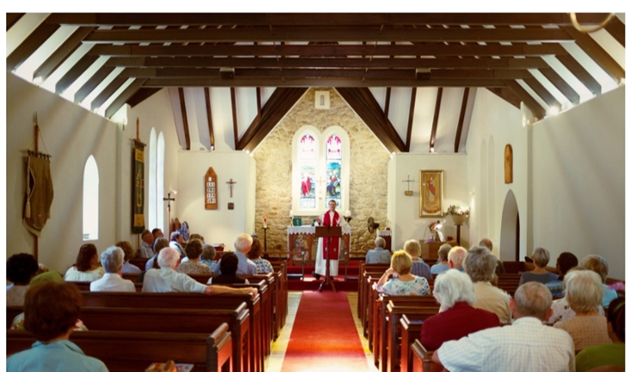

Slide 22
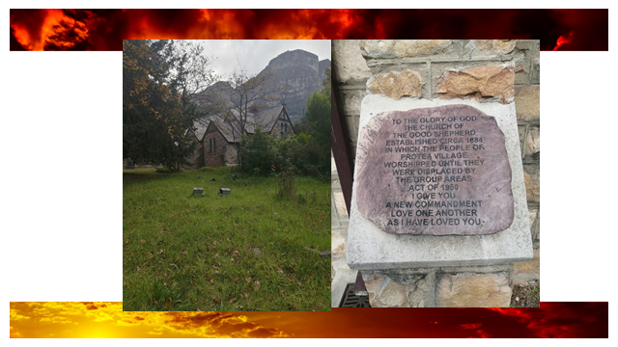

Slide 23
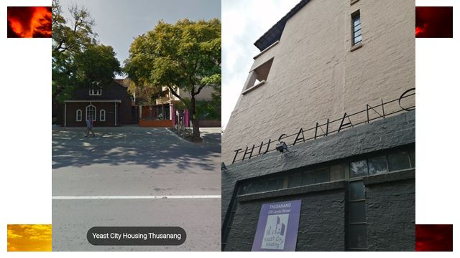

Slide 24
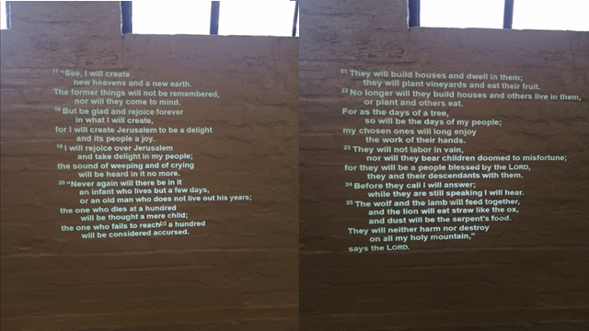
… just imagine

Slide 25
“New Hope in the Church” A partnership between New Hope SA and St Peters church, Mowbray?
Dinner - Microsite - Housing - ...
Charlie Alexander

Slide 26
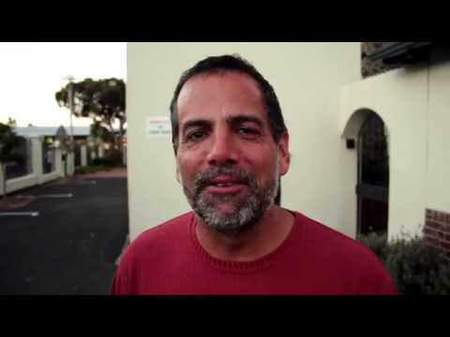

Slide 27
Dinner The Dinner at St Peters has been going for about a decade and forms part of the faith community in a way that has more potential than we may be able to comprehend.
Welcome
Hospitality
Inclusivity
Community
Sharing
Relationship

Slide 28
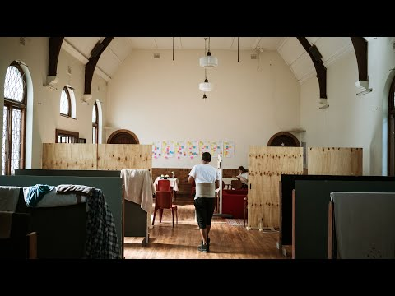

Slide 29
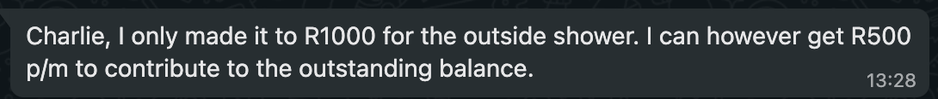
Microsite
Out of relationship people were invited
The Space was changed/adapted to suit the needs of the people
Crisis - Health, Education, Financial… Yet, Some were able to give

Slide 30
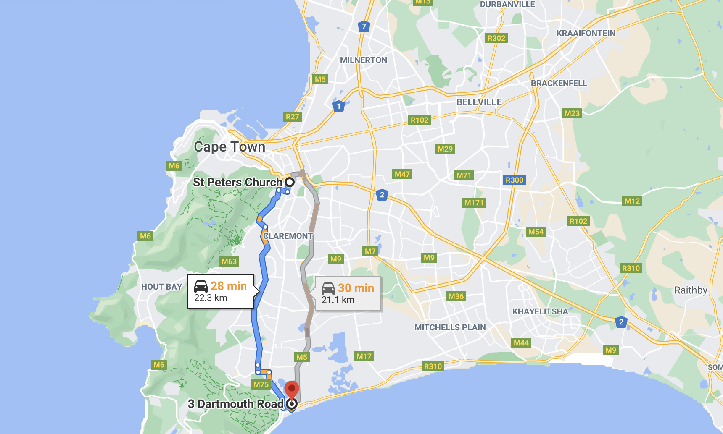

Slide 31
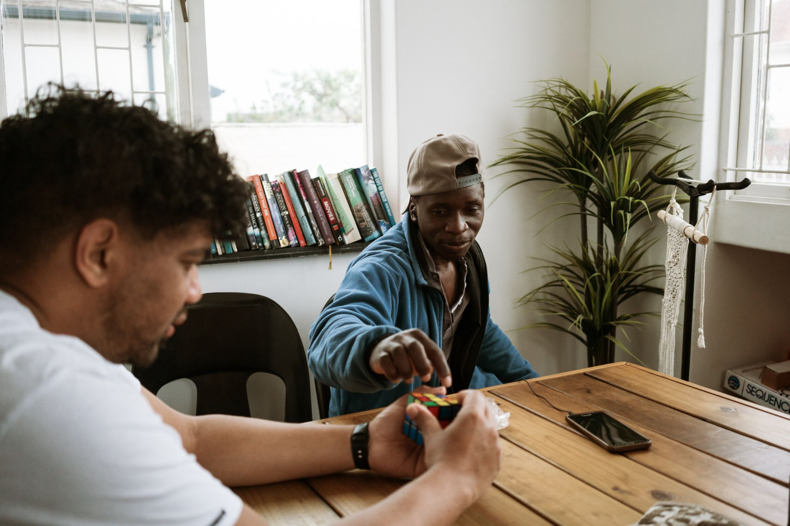
Genesis 1 v 26-27

Slide 32
“It is not our responsibility
to respond”
Stories from Tshwane
Wayne Renkin

Slide 33
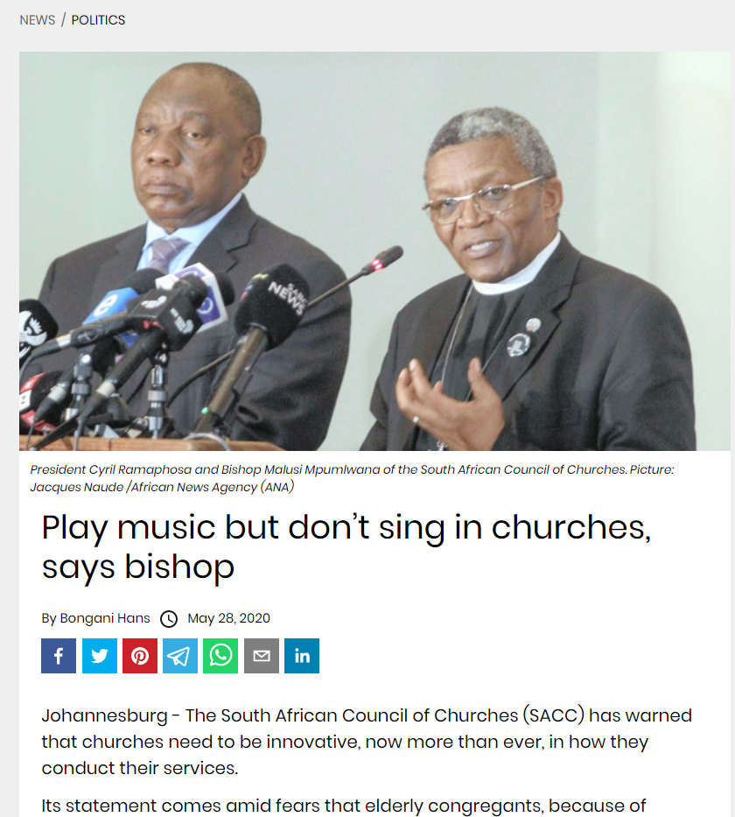
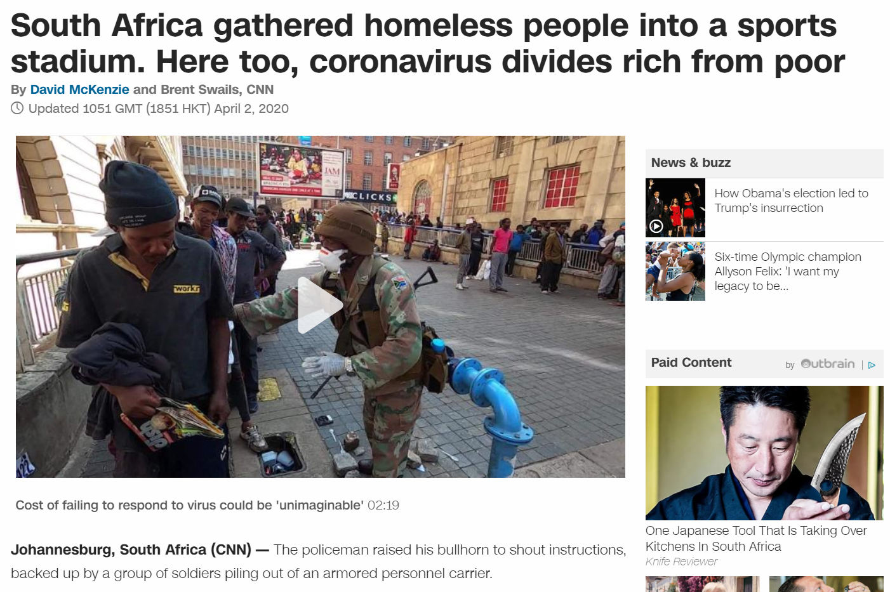

Slide 34
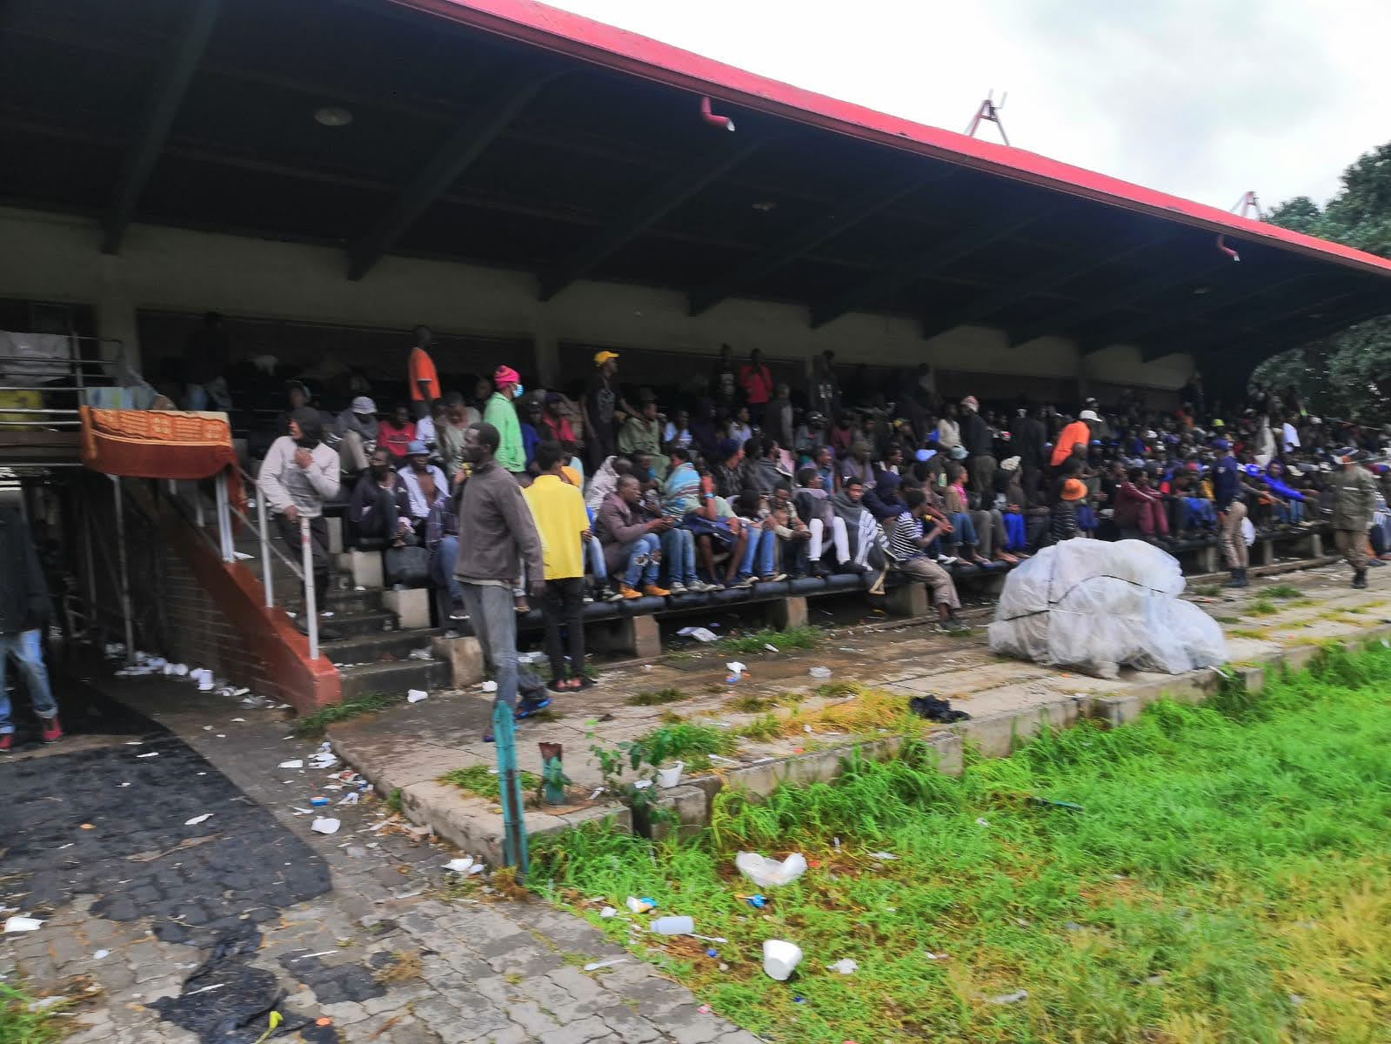
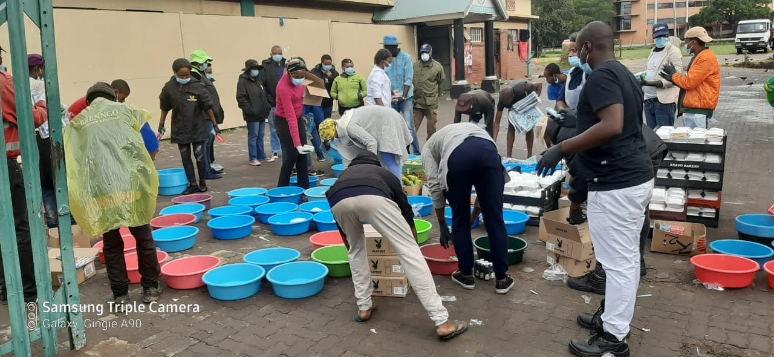

Slide 35
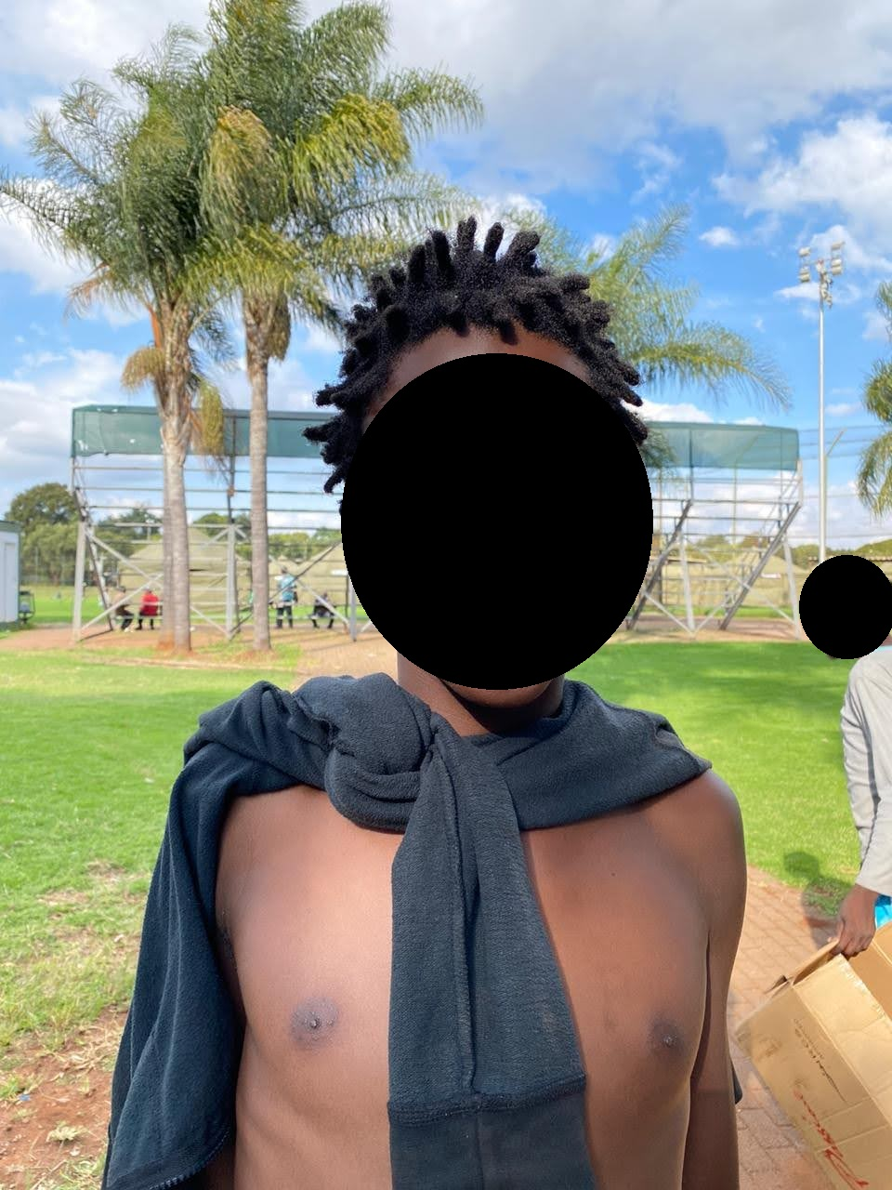
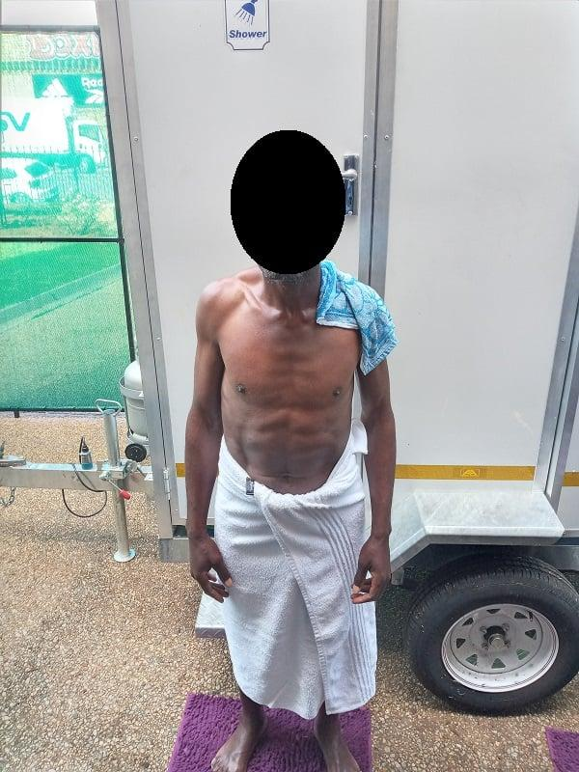
On whose social media account did these photos appear?
The Government or a Church?

Slide 36
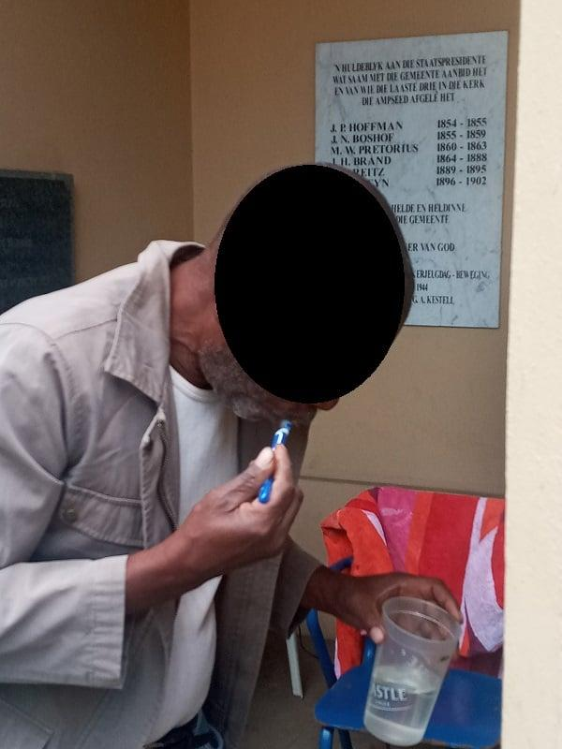
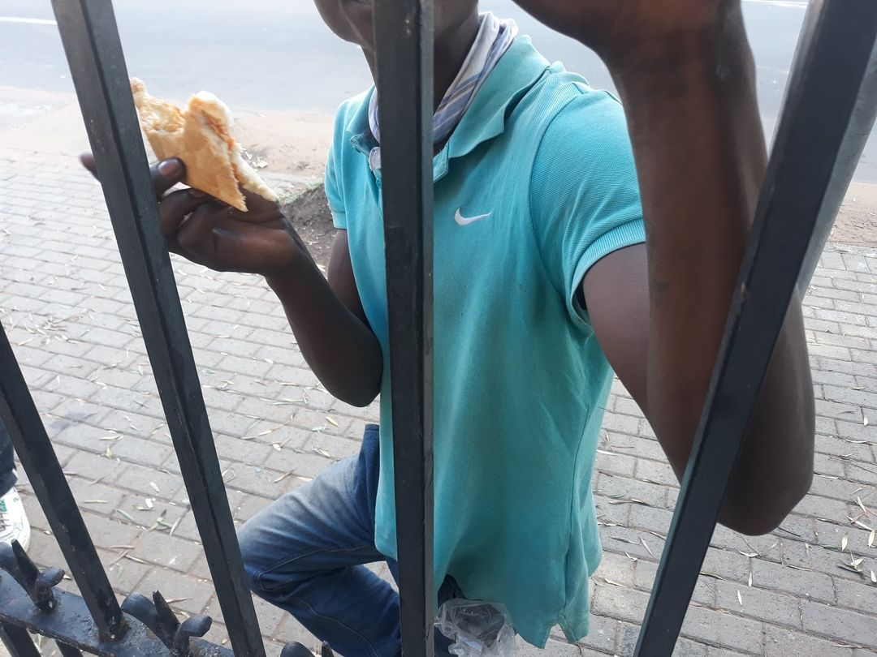
On whose social media account did these photos appear? The Government or a Church?

Slide 37
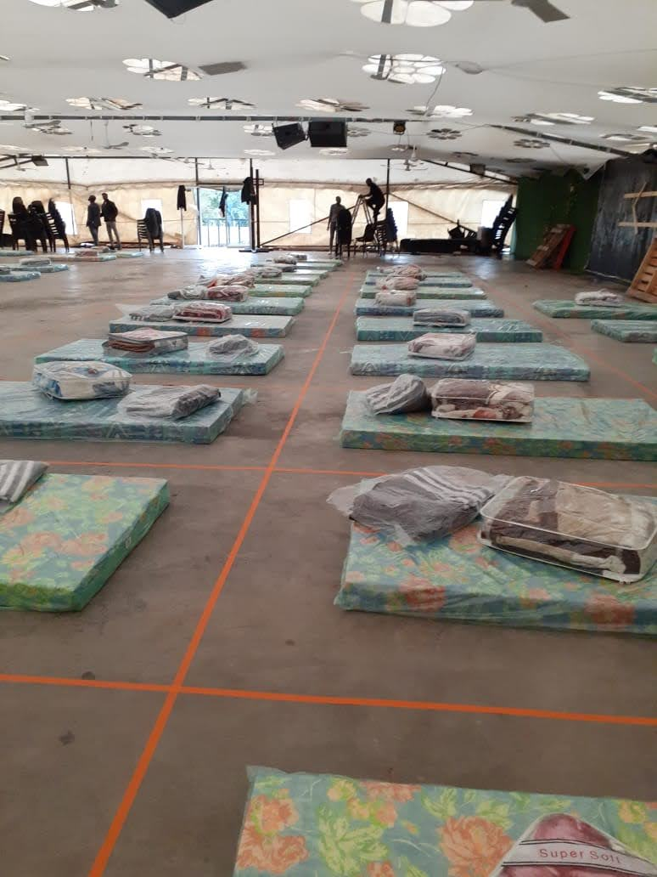
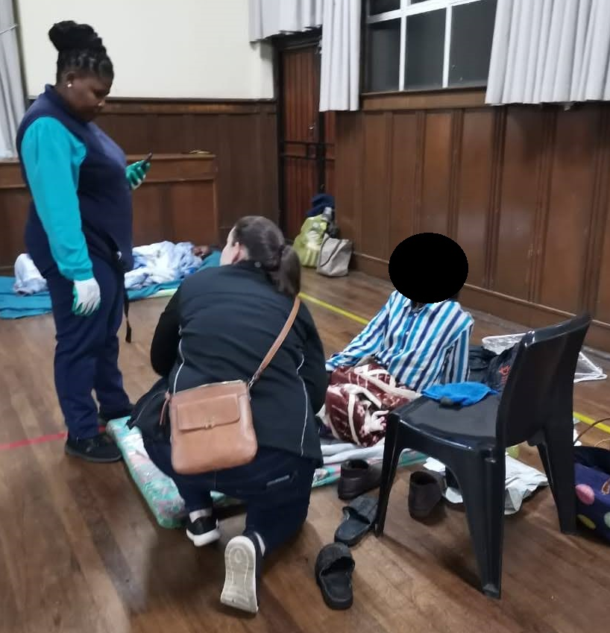

Slide 38
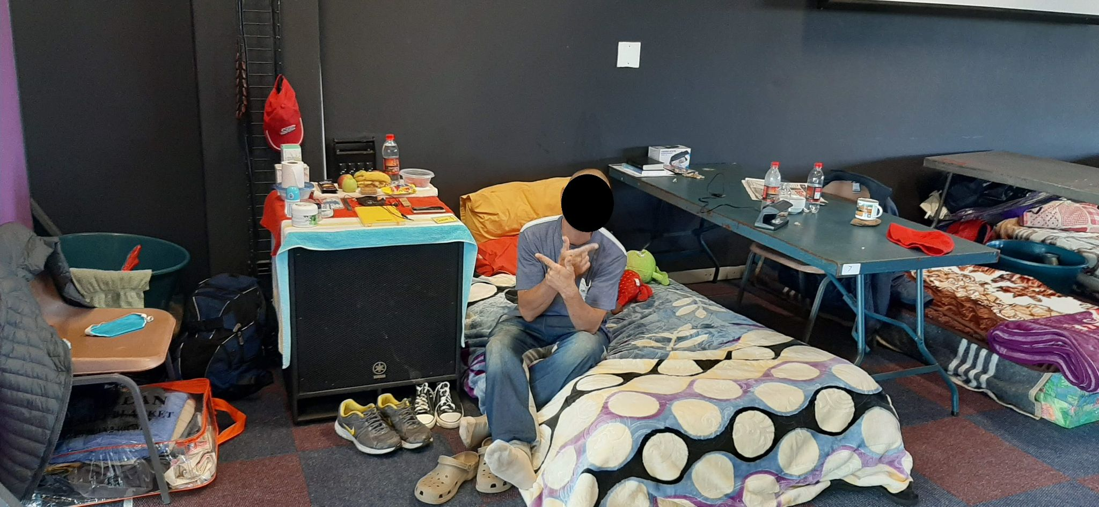

Slide 39
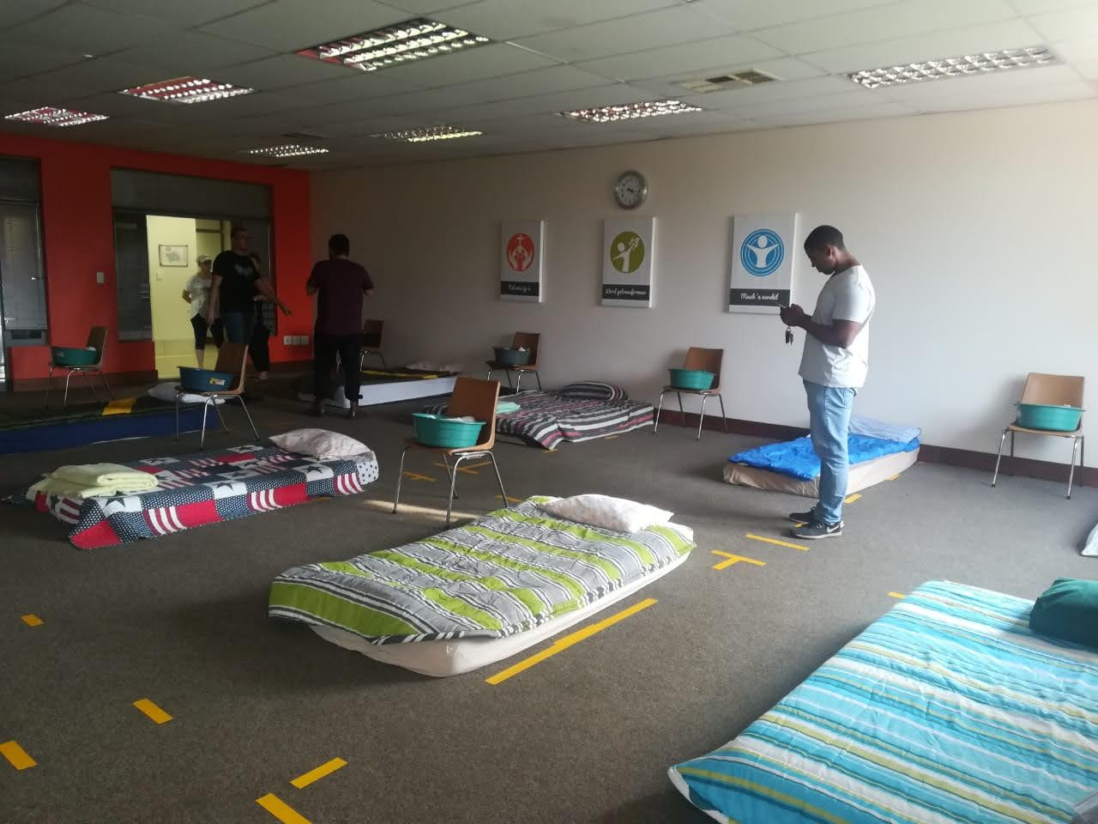

Slide 40
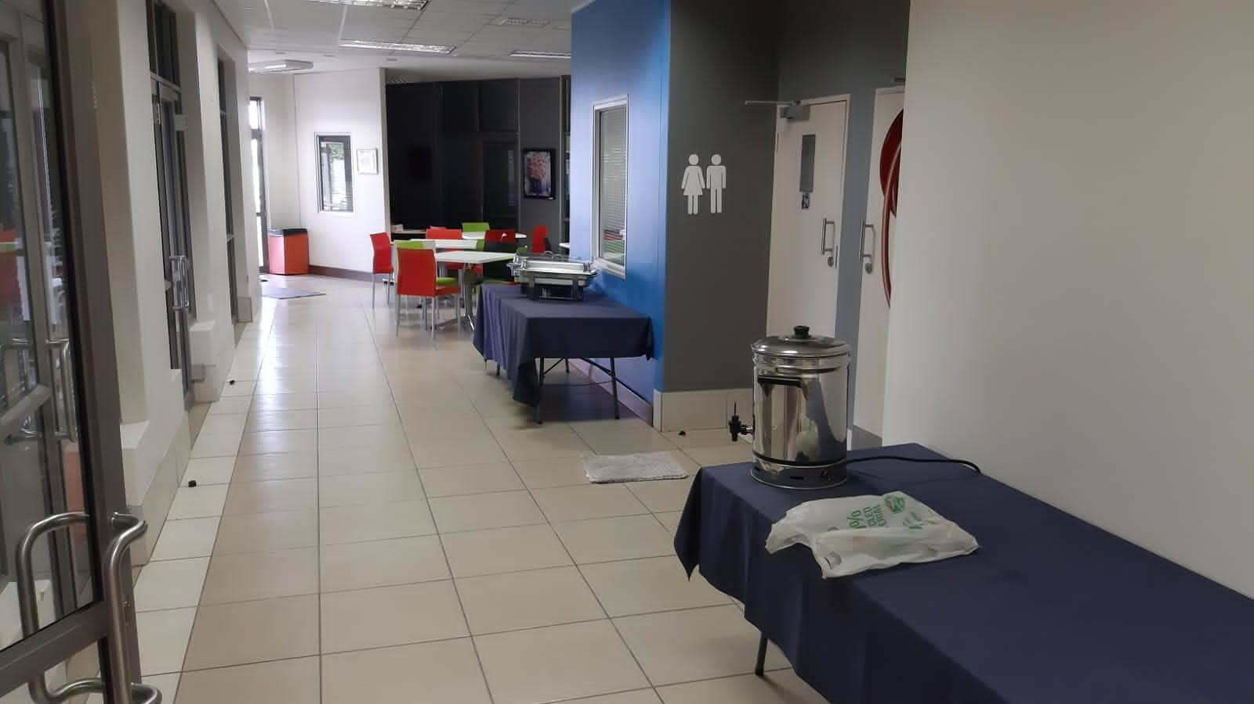

Slide 41
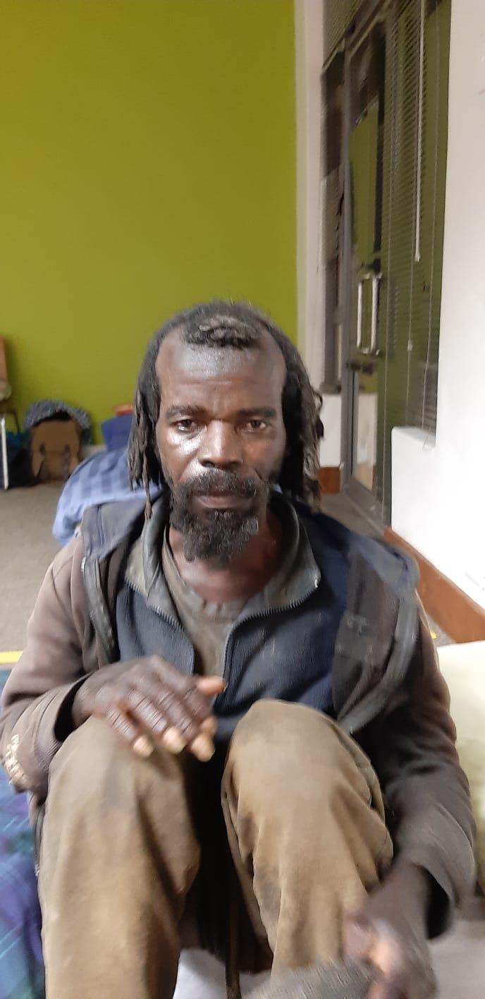
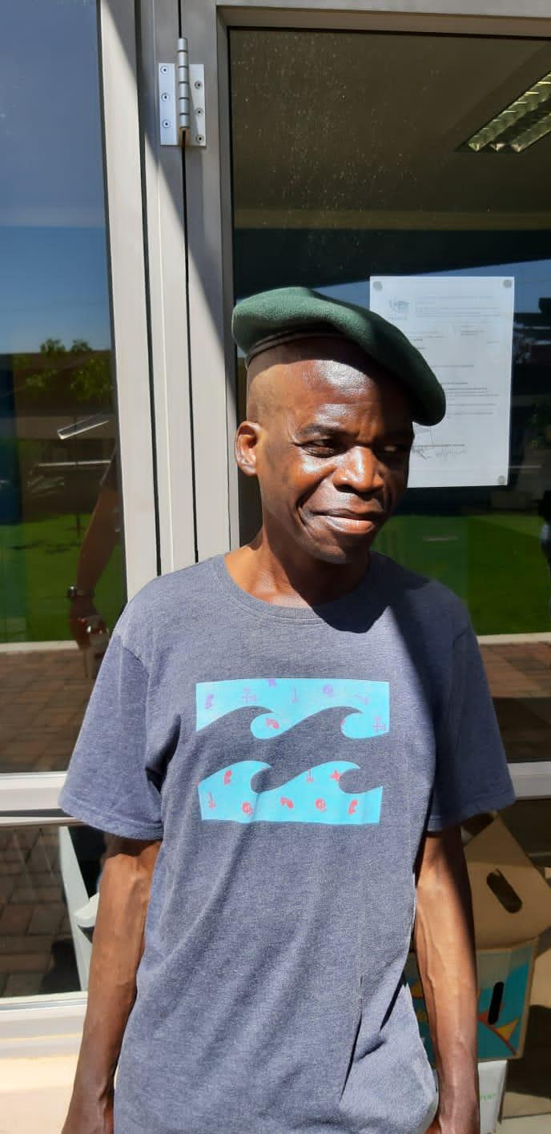

Slide 42
A time to reflect … think of the stories your heard in your discussion groups, from biblical texts, and from churches across South Africa
In the chat box, type your response
What have you heard from the stories?
What stood out for you?
Identify new ideas/ themes/ theological insights/ definitions that you heard in the stories

Slide 43
Going Forward … what next? What now?
Future(s) for the church on the corner
Disconnections?
…. between what we have heard and where we are?
When, not if, the crisis happens…
... steps for churches to respond
What do we need to change today for this to be realised tomorrow?
Are there missing collaborations?
… Who must I collaborate with? Who is not around the table?
How do churches identify the barriers that hinders them to respond?
POWER?? Who has the power?
What theologies are we engaging? With whom are we reading? Theologising?
Is there a step for me to take …. TODAY?

Slide 44
Links/ Contacts
National Homeless Network - national-network@homeless.org.za - https://homeless.org.za/national-homeless-network/
Resources on Homelessness in SA - https://www.research.centreforfaithandcommunity.co.za/research-repositories/pathways-out-of-homelessness-open-repository/
Resources on Homelessness and COVID-19 - https://homelessnessandcovid-19.weebly.com/
The Warehouse Trust - https://www.warehouse.org.za/
Institute of Global Homelessness - https://ighomelessness.org/
The Inkathalo Conversations - https://inkathaloconversations.co.za/
Echo Youth Development - https://www.echoyouth.co.za/
Tshwane Leadership Foundation - tlf.org.za
Denis Hurley Centre - http://www.denishurleycentre.org/
St Peter’s Church Mowbray Thursday Dinners
New Hope SA - https://www.newhopesa.org/

Slide 45
May God bless you
with a restless discomfort
about easy answers, half-truths,
and superficial relationships,
so that you may seek truth boldly
and love deep within your heart.

Slide 46
May God bless you
with holy anger
at injustice, oppression, and exploitation of people,
so that you may tirelessly work for justice, freedom, and peace among all people.

Slide 47
May God bless you
with the gift of tears to shed for those who suffer from pain, rejection, starvation, or the loss of all that they cherish, so that you may reach out your hand to comfort them and transform their pain into joy.

Slide 48
May God bless you
with enough foolishness
to believe that you really can make a difference in this world,
so that you are able, with God’s grace, to do what others claim cannot be done. Amen

